Slide 1
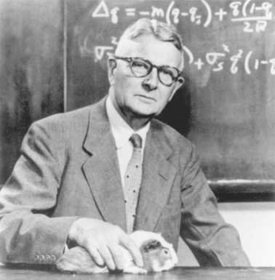
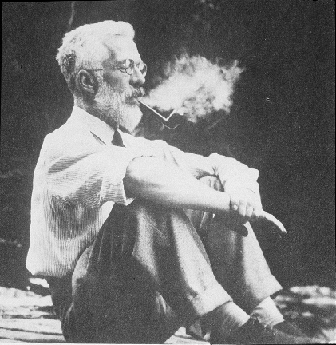
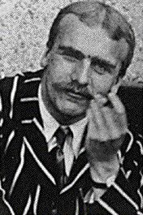
POP GEN 101

Slide 2

“We have the same situation in population genomics. People have vast amounts of data and do completely half-ass things with it because they don’t know any better. And, I wish there was some way of persuading people that we need to train students in the development and properties of the methods. And that means population genetics.”
– Joe Felsenstein

Slide 3
POPULATION GENETICS
The study of the distribution of genetic variation within and among populations, and the evolutionary processes that generate this variation.
Often, it involves quantifying genetic variation within and among populations, and inferring the evolutionary processes that generated it.

Slide 4
POP GEN 101
I. What is genetic variation? (terms and basic principles)
II. What determines the amount and distribution of genetic variation?
A. Genetic drift
B. Selection
C. Gene flow
D. Mutation
III. Effective population size (Ne)
IV. Neutral vs. adaptive genetic variation
V. Why genetics is important in conservation: molecular markers as tools & effect of genetics on fitness
VI. Population genomics: What is it? Steps involved? Power and limitations.

Slide 5
POP GEN 101
I. What is genetic variation? (terms and basic principles)
II. What determines the amount and distribution of genetic variation?
A. Genetic drift
B. Selection
C. Gene flow
D. Mutation
III. Effective population size (Ne)
IV. Neutral vs. adaptive genetic variation
V. Why genetics is important in conservation: molecular markers as tools & effect of genetics on fitness
VI. Population genomics: What is it? Steps involved? Power and limitations.

Slide 6
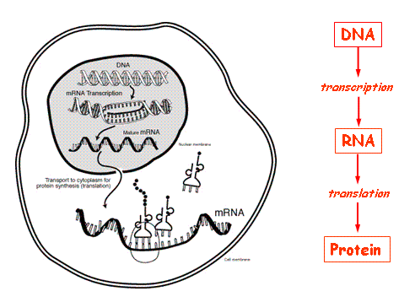
Terms and basic principles
“Central Dogma” of biology

Slide 7
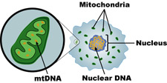
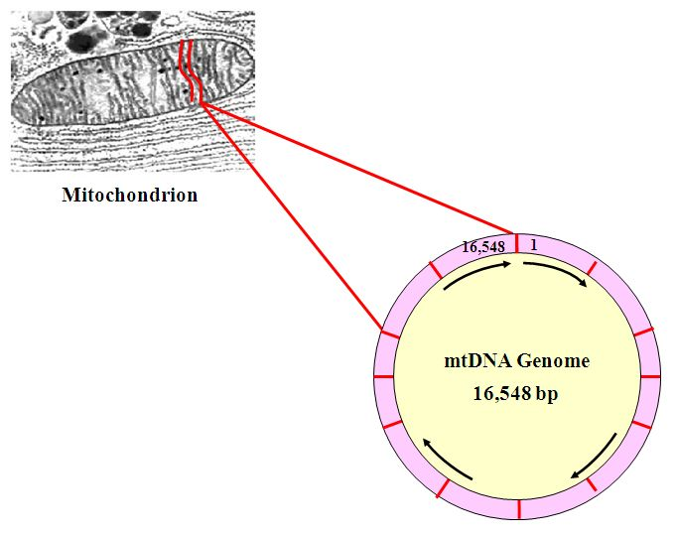
mtDNA vs. nDNA

Slide 8
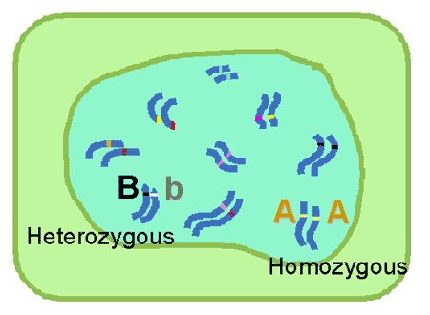
Terms and basic principles
Important terms
Gene
Locus (plural: loci)
Diploid
Allele
Heterozygote
Homozygote

Slide 9
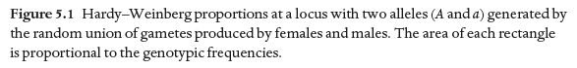
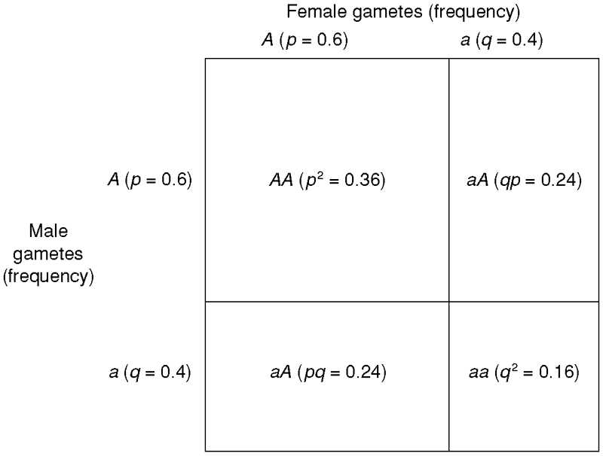
Terms and basic principles
Hardy-Weinberg proportions

Slide 10
Terms and basic principles
Hardy-Weinberg equilibrium assumptions
Random mating
Large population size
No natural selection
No gene flow
No mutation
Outcome of Hardy-Weinberg assumptions
Populations will not evolve (allele and genotype frequencies will remain constant across generations)
Genotypic frequencies in H-W proportions after 1 generation of mating

Slide 11
POP GEN 101
I. What is genetic variation? (terms and basic principles)
II. What determines the amount and distribution of genetic variation?
A. Genetic drift
B. Selection
C. Gene flow
D. Mutation
III. Effective population size (Ne)
IV. Neutral vs. adaptive genetic variation
V. Why genetics is important in conservation: molecular markers as tools & effect of genetics on fitness
VI. Population genomics: What is it? Steps involved? Power and limitations.

Slide 12
CAUSES OF EVOLUTION: GENETIC DRIFT
Hardy-Weinberg equilibrium assumptions
Random mating
Large population size
No natural selection
No gene flow
No mutation
What happens when violate assumption of large N?
Genetic drift: random change in allele frequencies across generations due to finite N
In other words, finite number of genes transmitted to progeny will be an imperfect sample of allele frequencies in the adults

Slide 13
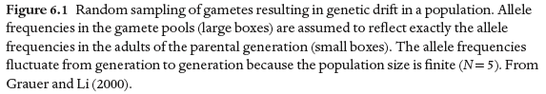
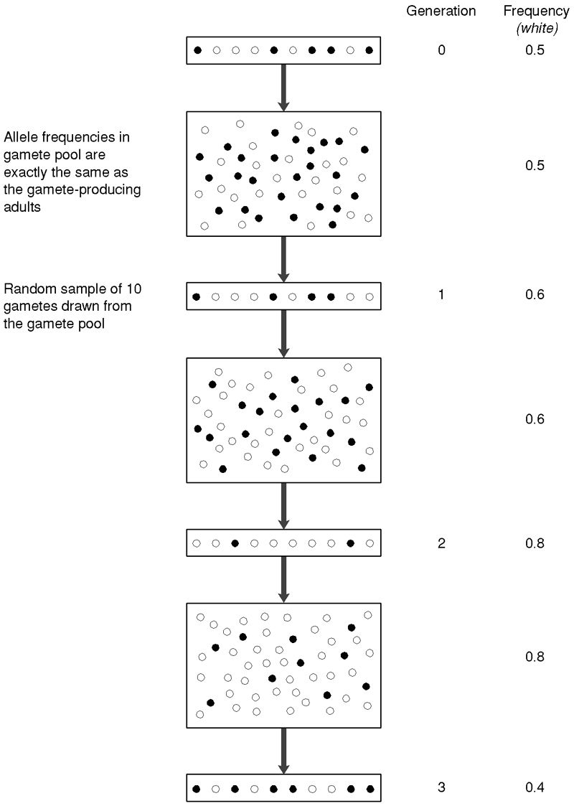
CAUSES OF EVOLUTION: GENETIC DRIFT
2 results of drift
Allele frequencies will change!
Genetic variation will be lost!
Δh = -1/2N

Slide 14
CAUSES OF EVOLUTION: SELECTION
Hardy-Weinberg equilibrium assumptions
Random mating
Large population size
No natural selection
No gene flow
No mutation
What happens when violate assumption of no selection?
Selection: differential fitness of different alleles & genotypes (many different forms of selection)
Selection can cause evolution too
Local adaptation: differential fitness of different alleles & genotypes in different environments

Slide 15
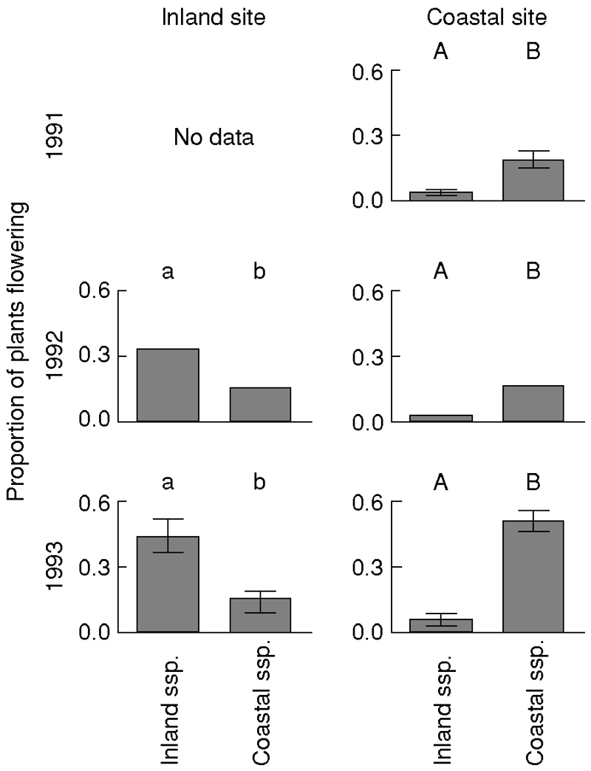
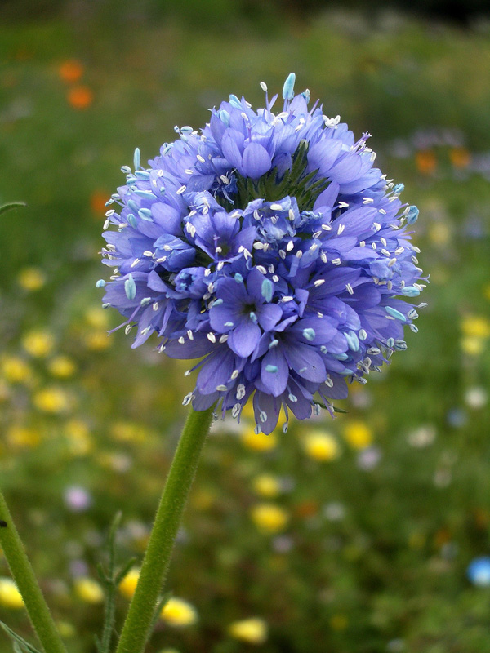
EXAMPLE OF LOCAL ADAPTATION
Native annual, Gilia capitata
Reciprocal transplant experiment b/n plants on CA coast and inland
Plants survived to flowering better in their local environment (= local adaptation)

Slide 16
FITNESS
Fitness: average number of offspring produced by individuals of a particular genotype
Effect of natural selection on genotypes measured by fitness
Calculated as product of viability and fertility
Genotype Viability Fertility Fitness
AA v₁₁ f₁₁ (v₁₁)(f₁₁)=w₁₁
Aa v₁₂ f₁₂ (v₁₂)(f₁₂)=w₁₂
Aa v₂₂ f₂₂ (v₂₂)(f₂₂)=w₂₂

Slide 17
DIRECTIONAL SELECTION
Occurs when one allele is always at a selective advantage
Allele under selection may be dominant, recessive, or intermediate
Dominant w₁₁ = w₁₂ > w₂₂
Intermediate w₁₁ > w₁₂ > w₂₂
Recessive w₁₁ > w₁₂ = w₂₂
Advantageous allele will increase in frequency and will ultimately be fixed under all three modes of natural selection
However, rate of change in allele freq depends on mode of dominance relationships

Slide 18
HETEROZYGOUS ADVANTAGE
Occurs when heterozygote has the greatest fitness:
w₁₁ < w₁₂ > w₂₂
Will maintain both alleles in the population

Slide 19
CAUSES OF EVOLUTION: GENE FLOW
Hardy-Weinberg equilibrium assumptions
Random mating
Large population size
No natural selection
No gene flow
No mutation
What happens when violate assumption of no gene flow?
Gene flow: movement of alleles from one population to another via dispersal (also called “migration” in pop. genetics)
Gene flow reduces differences among populations and increases GV within pops.

Slide 20
POPULATION STRUCTURE
Genetic variation within and among populations
> Fst a measure of genetic differentiation
Aa
Fst = 0.00
Aa
AA
aa
Aa
Aa
Fst = 1.00
Pop 1
f(A) = 0.5
f(a) = 0.5
H = 0.5
Aa
Aa
Pop 1
f(A) = 0.0
f(a) = 1.0
H = 0.0
Pop 2
f(A) = 0.5
f(a) = 0.5
H = 1.0
Pop 2
f(A) = 1.0
f(a) = 0.0
H = 0.00
aa
aa
aa
aa
AA
AA
AA
AA

Slide 21
CAUSES OF EVOLUTION: GENE FLOW
Hardy-Weinberg equilibrium assumptions
Random mating
Large population size
No natural selection
No gene flow
No mutation
What happens when violate assumption of no mutation?
Mutation: formation of new alleles caused by changes in DNA
Ultimate source of genetic variation, increasing within population genetic variation

Slide 22
MOLECULAR MUTATIONS
Types of molecular mutations:
Substitutions: replacement of one nucleotide with another
Recombinations: exchange of a sequence from one homologous chromosome to the other
Deletions: Loss of one or more nucleotides
Insertions: Addition of one or more nucleotides
Inversions: Rotations by 180° of a double-stranded DNA segment of two or more bp’s

Slide 23
MUTATION
How common are mutations?!?!
Per locus level: RARE
E.g., Few per billion base pairs per generation
Genome level: COMMON
Most species’ genomes contains billions of nucleotides
Most species’ genomes contain hundreds of mutations (Lynch et al. 1999)

Slide 24
SUMMARY OF EFFECTS OF 4 EVOLUTIONARY FORCES ON GENETIC VARIATION
________Effect on genetic variation ____
FORCE WITHIN populations AMONG populations
Genetic drift
⬇
⬆
Directional
selection
⬇
⬆
Heterozygous advantage
⬆
⬇
Gene flow
⬆
⬇
Mutation
⬆
⬆⬇?

Slide 25
POP GEN 101
I. What is genetic variation? (terms and basic principles)
II. What determines the amount and distribution of genetic variation?
A. Genetic drift
B. Selection
C. Gene flow
D. Mutation
III. Effective population size (Ne)
IV. Neutral vs. adaptive genetic variation
V. Why genetics is important in conservation: molecular markers as tools & effect of genetics on fitness
VI. Population genomics: What is it? Steps involved? Power and limitations.

Slide 26
EFFECTIVE POPUALTION SIZE (Ne)
If know population size, can predict rate of loss of heterozygosity
Δh = -1/2N
BUT…N in above equation not “census population size” (Nc), which is the total number in population
Instead, N above is the “effective population size” (Ne), which can be thought of as the number of individuals contributing their genes to the next generation
Many factors affect how much lower Ne is than Nc:
Unequal sex ratio
Variance in number of progeny
Fluctuating population size

Slide 27
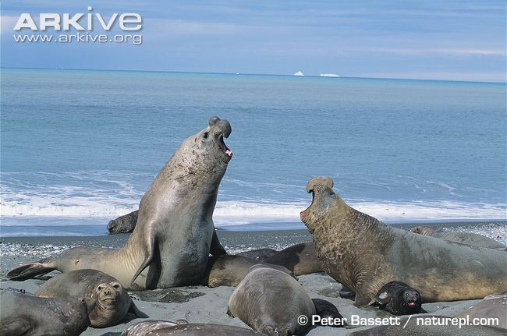
EFFECTIVE POPUALTION SIZE (Ne)
Consider extreme case of one male mating with 100 females
In this case, all progeny will be half sibs even though total N = 101
Can estimate N_{e} as:
In this case, N_{e} = 4!

Slide 28
POP GEN 101
I. What is genetic variation? (terms and basic principles)
II. What determines the amount and distribution of genetic variation?
A. Genetic drift
B. Selection
C. Gene flow
D. Mutation
III. Effective population size (Ne)
IV. Neutral vs. adaptive genetic variation
V. Why genetics is important in conservation: molecular markers as tools & effect of genetics on fitness
VI. Population genomics: What is it? Steps involved? Power and limitations.

Slide 29
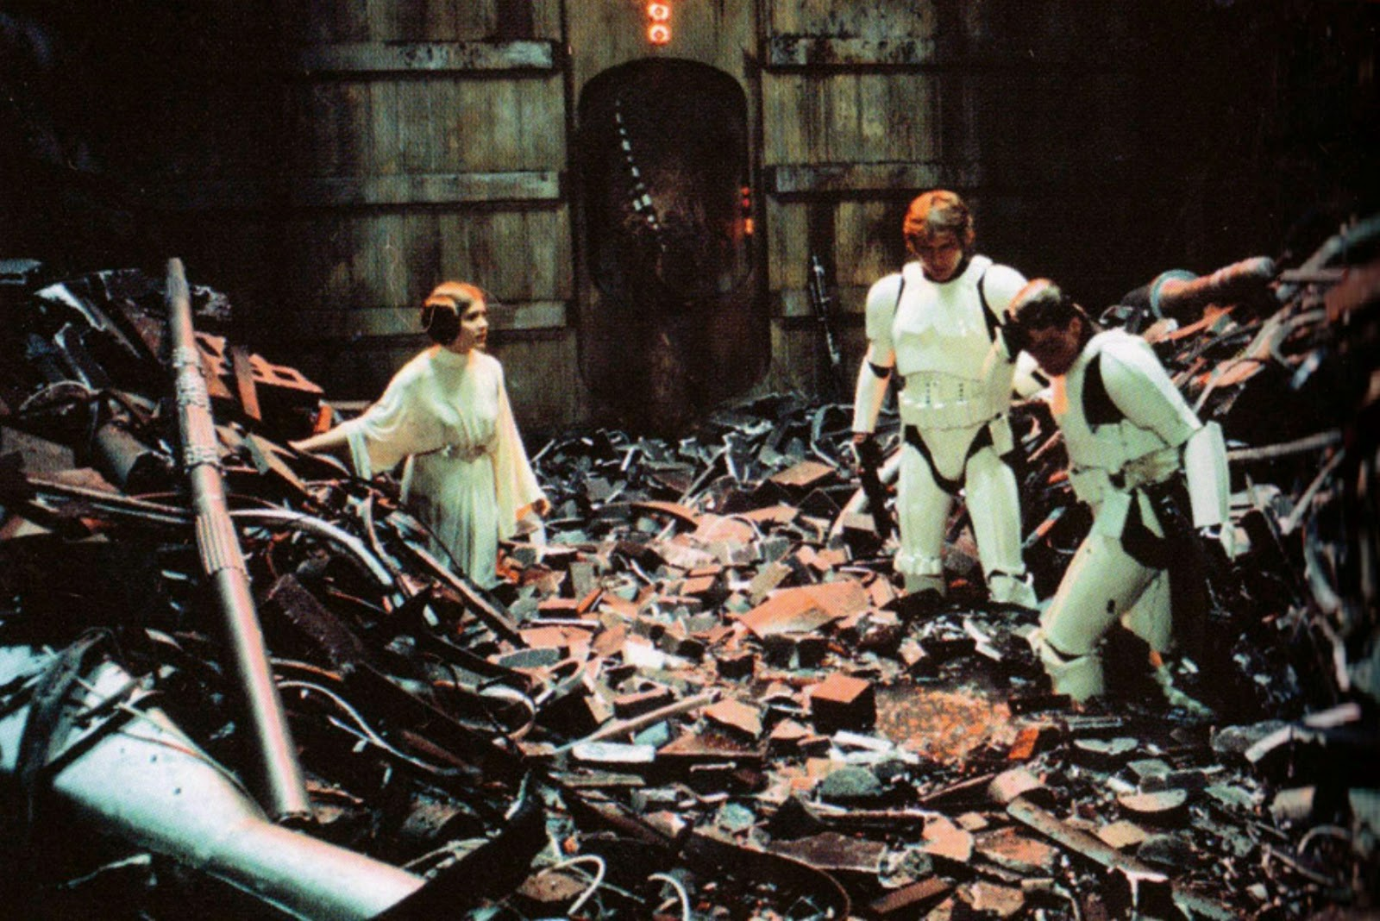
ADAPTIVE VS. NEUTRAL GENETIC VARIATION
Most of your DNA is “junk”!!!
<2% of the human genome is “coding” (transcribed into mRNA and then translated into proteins)
Much of the non-coding portion of the genome is “neutral” (b/c not functional, selection doesn’t act on it)
“Neutral” genetic variation → selection doesn’t act on it (only drift, gene flow, and mutation)
“Adaptive” genetic variation → selection DOES act on it (in addition to drift, gene flow, and mutation)

Slide 30
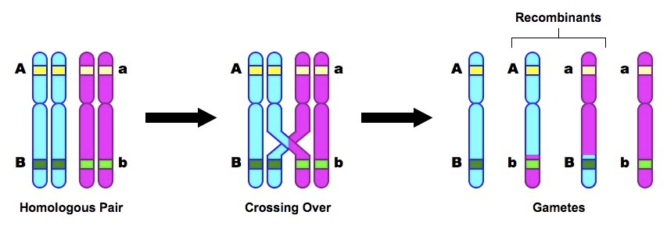
ADAPTIVE VS. NEUTRAL GENETIC VARIATION
How can different evolutionary processes act on different parts of the same genome?!?
Different chromosomes and recombination!

Slide 31
POP GEN 101
I. What is genetic variation? (terms and basic principles)
II. What determines the amount and distribution of genetic variation?
A. Genetic drift
B. Selection
C. Gene flow
D. Mutation
III. Effective population size (Ne)
IV. Neutral vs. adaptive genetic variation
V. Why genetics is important in conservation: molecular markers as tools & effect of genetics on fitness
VI. Population genomics: What is it? Steps involved? Power and limitations.

Slide 32
WHY GENETICS IS IMPORTANT IN CONSERVATION
1. “Molecular markers” (i.e., loci) can be used to infer demographic parameters, evolutionary history, and local adaptation
Neutral loci: Can be used to infer demographic parameters (e.g., Ne, gene flow) and evolutionary history (phylogenetic trees)
Fst = 1 / (4Nm + 1)
Loci under selection: Can be used to infer patterns of local adaptation

Slide 33
WHY GENETICS IS IMPORTANT IN CONSERVATION
2. Genetic variation affects individual fitness, population persistence, and the capacity to adapt
Inbreeding depression: Reduction in fitness due to mating among close relatives
Adaptive potential: The rate of adaptive evolution is proportional to the amount of genetic variation

Slide 34
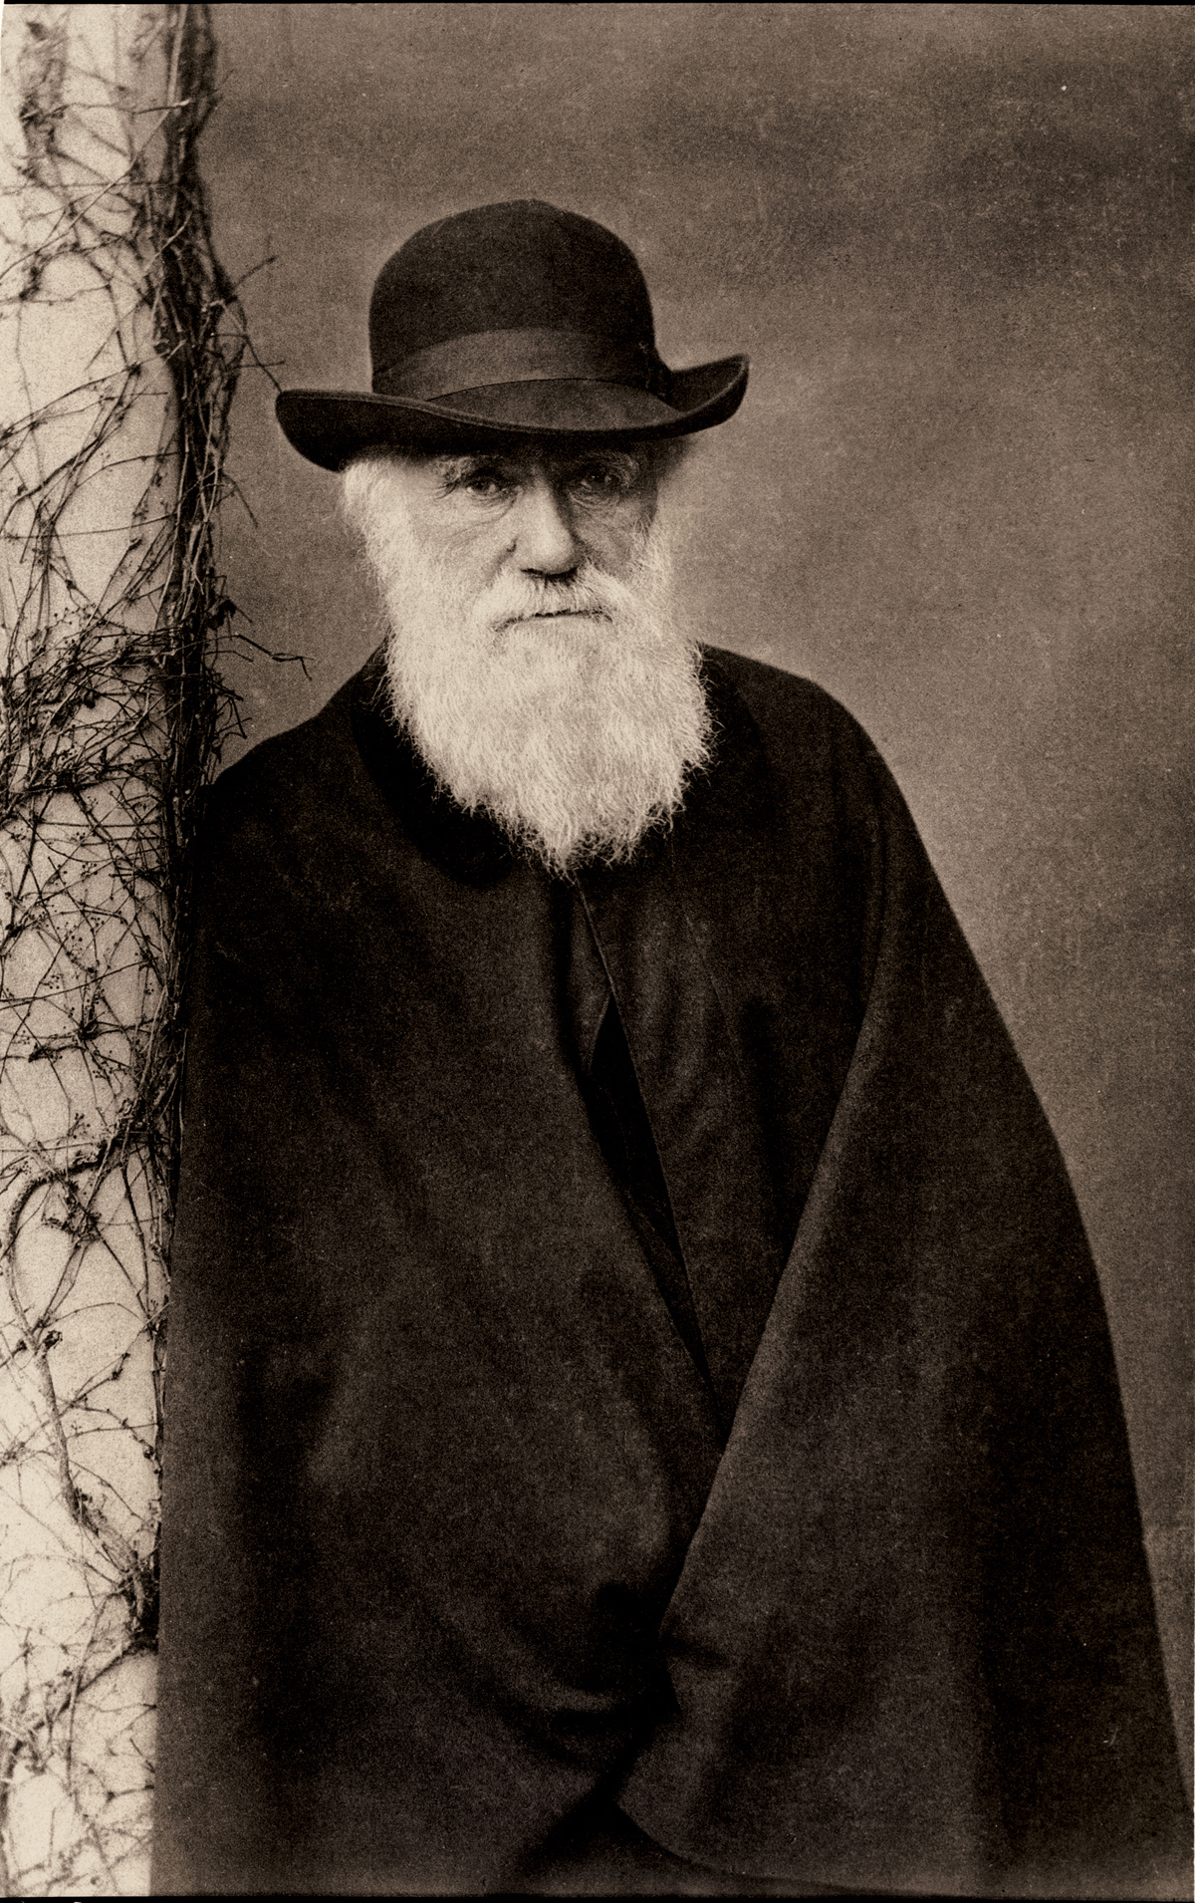

WHY GENETICS IS IMPORTANT IN CONSERVATION
“As some of our British parks are ancient, it occurred to me that there must have been long-continued close interbreeding with the fallow-deer (Cervus dama) kept in them; but on inquiry I find that it is a common practice to infuse new blood by procuring bucks from other parks.” Charles Darwin (1896)

Slide 35
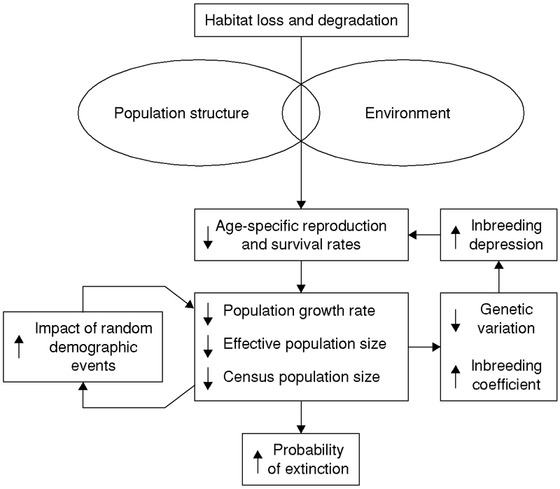
WHY GENETICS IS IMPORTANT IN CONSERVATION
Extinction vortex:

Slide 36
POP GEN 101
I. What is genetic variation? (terms and basic principles)
II. What determines the amount and distribution of genetic variation?
A. Genetic drift
B. Selection
C. Gene flow
D. Mutation
III. Effective population size (Ne)
IV. Neutral vs. adaptive genetic variation
V. Why genetics is important in conservation: molecular markers as tools & effect of genetics on fitness
VI. Population genomics: What is it? Steps involved? Power and limitations.

Slide 37
POPULATION GENOMICS
DEFINITION:
Black et al. (2001): “simultaneous sampling of numerous variable loci within a genome and the inference of locus-specific effects from the sample distributions.”
Luikart et al. (2003): “simultaneous study of numerous loci or genome regions to better understand the roles of evolutionary processes (such as mutation, random genetic drift, gene flow and natural selection) that influence variation across genomes and populations.”

Slide 38
POPULATION GENOMICS
DEFINITION:
Allendorf & Luikart (2007): “refers to the study of many DNA markers (e.g., mapped markers and coding genes) in many individuals from different populations.”

Slide 39
POPULATION GENOMICS
GOALS:
Identify outlier loci
Test for signature of selection
Identify loci under selection
Infer evolutionary or demographic parameters without bias caused by loci under selection

Slide 40
POPULATION GENOMICS
RELATIONSHIP W/ POPULATION GENETICS
Population genomics just “population genetics writ large”?
Yes?: Long-recognized that analyzing only a few loci or only one class of markers can provide an incomplete or biased view of genome and of population history or relationships

Slide 41
POPULATION GENOMICS
RELATIONSHIP W/ POPULATION GENETICS
Population genomics just “population genetics writ large”?
No?: Only now is it possible to genotype vast numbers of marker loci (“genome typing”) in many individuals and populations of non-model organisms. Also, new software available to ID outlier loci.

Slide 42
POPULATION GENOMICS
RELATIONSHIP W/ POPULATION GENETICS
Thus although population genomics goals not new, we’re finally in a position to ID outliers and make evolutionary inferences based on HUGE numbers of loci

Slide 43
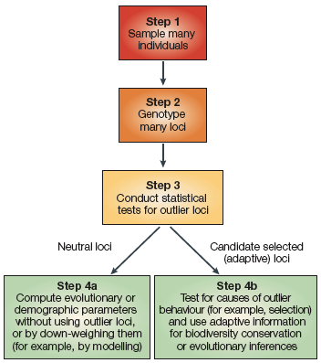
STEPS OF POPULATION GENOMICS

Slide 44
STEP 1: Sample many individuals
First step is to sample dozen or hundreds of individuals from one or more populations
Specific sampling design and sample sizes depends on question:
Estimating N_{e}: 30-50 individuals from a single population might be adequate
Estimating adaptive genetic differentiation: 100s of individuals across a geographic selection gradient

Slide 45
STEP 1: Sample many individuals
Example of sampling design to test for divergent selection across elevational gradient:
ELEVATIONAL TRANSECT 1
ELEVATIONAL TRANSECT 2
30-50 individuals
per population
30-50 individuals
per population
Total N = 270–450
Total N = 270–450

Slide 46
STEP 2: Genotype many loci
Second step is to genotype many loci (tens to hundreds):
Neutral loci:
Prerequisite for accurately inferring demographic history
Also necessary for providing neutral baseline to test for statistical outlier loci (potentially under selection)
Candidate or functional genes:
If don’t have candidate loci (i.e., non-models), gene-rich regions can be screened

Slide 47
STEP 3: Conduct statistical
tests for outlier loci
Third step is to identify outlier loci using statistical tests
Various types of aberrant behavior that may be caused by selection:
Exceptionally high or low F_{st}
Excess or deficit of heterozygous genotypes (F_{is} outliers, where F_{is} is a index of deviation from HW prop.)
Excess of low frequency alleles (homozygosity excess)
Deficit of low frequency alleles (heterozygosity excess)

Slide 48
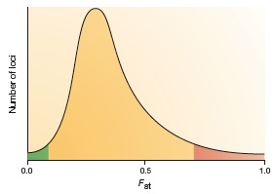
STEP 3: Conduct statistical
tests for outlier loci
Example of loci that are F_{st} outliers:
What type of selection predicted to cause extremely high Fst outliers?
What type of selection predicted to cause extremely low Fst outliers?

Slide 49
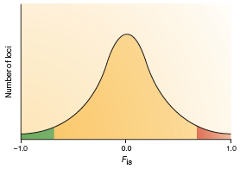
STEP 3: Conduct statistical
tests for outlier loci
Example of loci that are F_{is} outliers:

Slide 50
STEP 3: Conduct statistical
tests for outlier loci
Two general statistical approaches for testing outlier loci:
Theoretical (simulated) null distribution of a summary statistic (e.g., F_{st}):
Simulate expected null distribution for neutral loci w/ different population structures (Nm and Ne) and evolutionary histories
2. Empirical (observed) distribution of summary statistic:
Advantage: Controls for demographic history

Slide 51
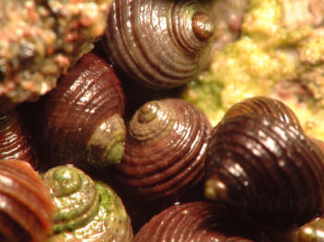
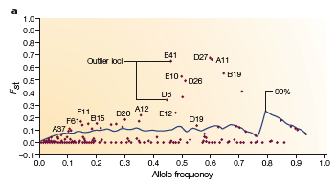
Example of testing for outliers using a theoretical null distribution of F_{st}:
Wilding et al. (2001) genotyped 306 AFLP loci in the intertidal snail Littorina saxatils
15 loci had extremely high F_{st} values (> 0.20-0.30) compared w/ mean of <0.04
Solid line is the upper 99% CI for simulated neutral loci

Slide 52
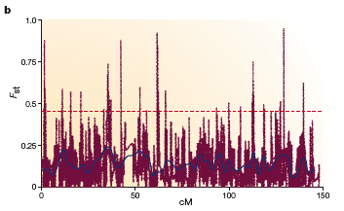
Example of testing for outliers using an empirical null distribution of F_{st}:
Akey et al. (2002) genotyped many SNP loci on human chromosome 8
Horizontal dashed line is the threshold for identifying extremely high F_{st} values

Slide 53
STEP 4a: Compute evolutionary or demographic parameters without using outlier loci
If interest is in demography/evolutionary history, final step is using validated neutral loci to infer these parameters
This important, because only one or a few outliers can strongly bias estimates

Slide 54
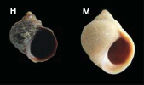
STEP 4a: Compute evolutionary or demographic parameters without using outlier loci
Example: Effect of outlier loci in Littorina saxatilis
Two morphotypes:
Thin shell and wide aperture (H) found high in the littoral zone
Thick shell and narrow aperture (M) found low in littoral zone

Slide 55
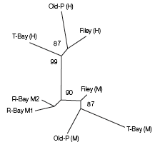
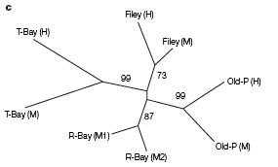
STEP 4a: Compute evolutionary or demographic parameters without using outlier loci
Example: Effect of outlier loci in Littorina saxatilis
AFLP phylogeny WITH
outlier loci
AFLP phylogeny
WITHOUT outlier loci
Groups based on morphotype
Groups based on geography

Slide 56
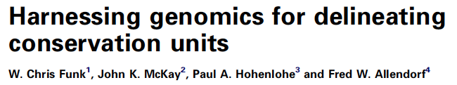
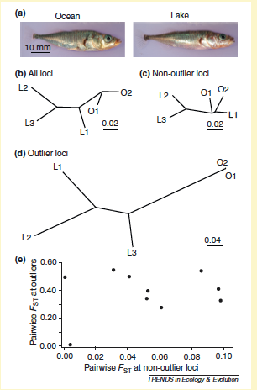

Slide 57
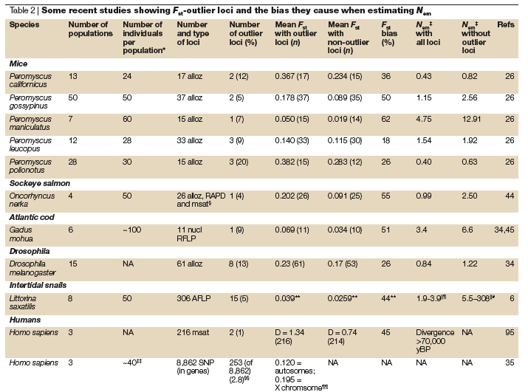
STEP 4a: Compute evolutionary or demographic parameters without using outlier loci

Slide 58
STEP 4b: Test for causes of outlier behavior (for example, selection)
If interest is in adaptive divergence and selection, final step is to confirm that outlier loci under selection
Alternative (null) hypothesis is that outlier because of Type I error (erroneous ID)
For example, when conducting 100 tests of whether Fst higher than expected, an average of 5 loci will be erroneously identified as outliers
Important to have a priori hypotheses to avoid weak inference about cause of selection

Slide 59
STEP 4b: Test for causes of outlier behavior (for example, selection)
Ways to confirm outlier behavior caused by selection:
Genome position: markers in or near strong candidate genes more likely to be under selection than random markers or markers far from genes
Conduct complementary population genomic approaches: for example, Fst outliers within QTLs can show that differentiation b/n ecotypes at adaptive QTL-linked loci maintained by divergent selection
Genotype across independent ecological gradients: can provided repeated, independent evidence for outlier behavior

Slide 60
PROMISE OF POPULATION GENOMICS
One important approach for identifying loci under selection
2. By IDing loci under selection, can remove these loci and estimate evolutionary and demographic parameters more accurately
3. Outlier loci useful in conservation, for example, for defining “adaptively” distinct populations

Slide 61
LIMITATIONS OF POPULATION GENOMICS
Significant investment of time and money required for marker development and “genome typing”
2. If just using non-functional markers (e.g., microsatellites, some SNPs), outlier loci do not necessarily = loci underlying local adaptation
Therefore, important to use neutral & functional loci

Slide 62
POP GEN 101
I. What is genetic variation? (terms and basic principles)
II. What determines the amount and distribution of genetic variation?
A. Genetic drift
B. Selection
C. Gene flow
D. Mutation
III. Effective population size (Ne)
IV. Neutral vs. adaptive genetic variation
V. Why genetics is important in conservation: molecular markers as tools & effect of genetics on fitness
VI. Population genomics: What is it? Steps involved? Power and limitations.

